Slide 1
AlphaFold 2 and its extension for 1. protein-protein interaction modelling 2. alternative structure sampling
Dinner group ML JournalClub
Jan. 11. 2024
Kwanghoon Jeong, Spencer Guo

Slide 2
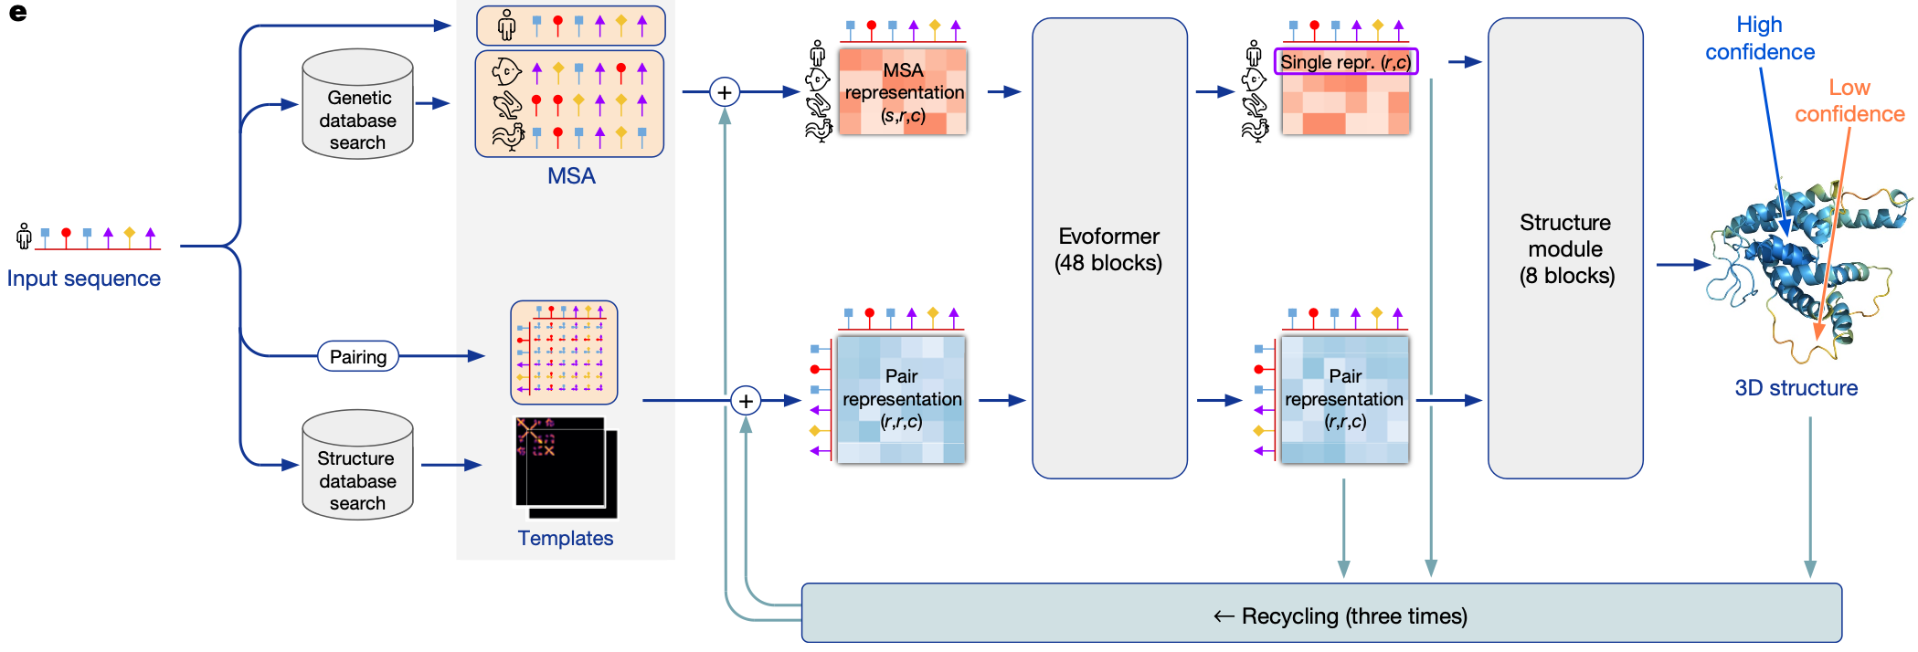
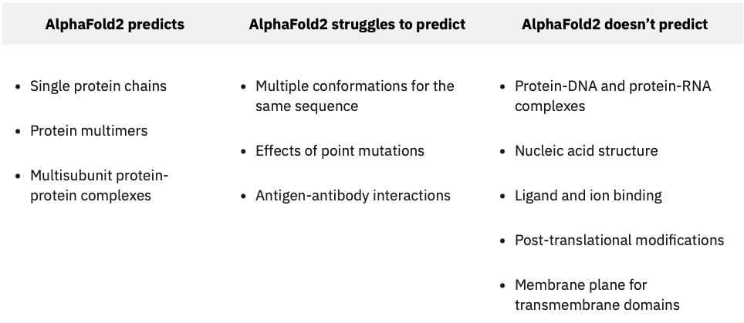
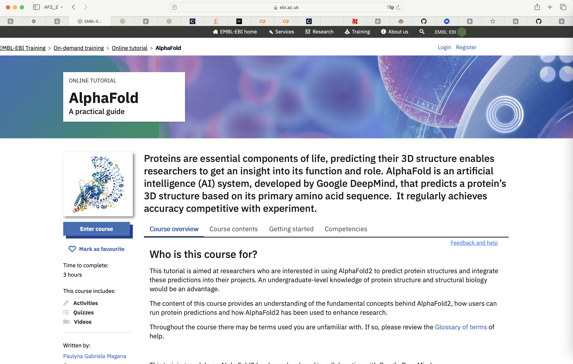
1. AlphaFold2
a. Input / Output
b. Input Embedding
c. Evoformer
d. Structure module
2. Its variants
EMBL_tutorial
AF-complex
AF-multimer
AF-pulldown
AF-cluster

Slide 3

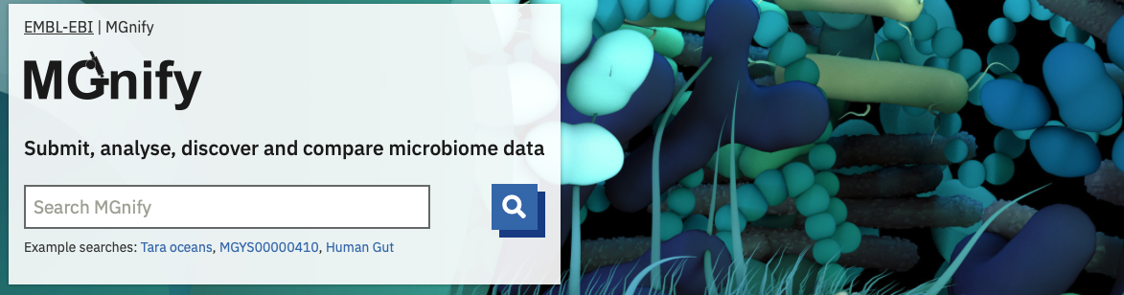
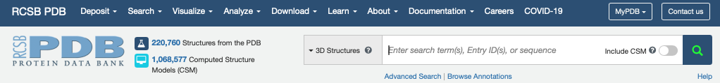
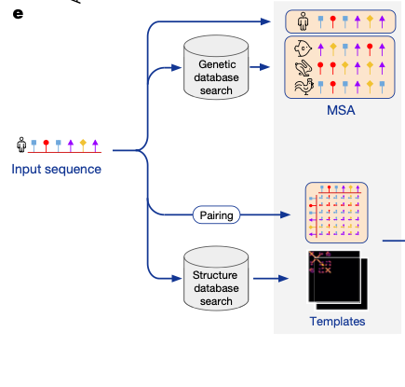
Input and Output
Input:
Amino acid sequence
Data base
Genetic Database
Structure Database
Genetic Database:
MGnify, UniProt
Uniclust30, UniRef90, BFD
Structure Database:
PDB70
Search algorithm: JackHMMER, HHBlits, HHSearch, MMseqs2
During training:
Filter out sequences when any single amino acid accounts for more than 80% of the input primary sequence
Filter out templates that are identical to (or a subset of) the input primary sequence
Show the model potentially bad templates, or no templates at all.
To make sure the model cannot rely on just copying the template.

Slide 4
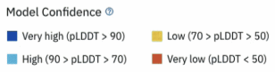
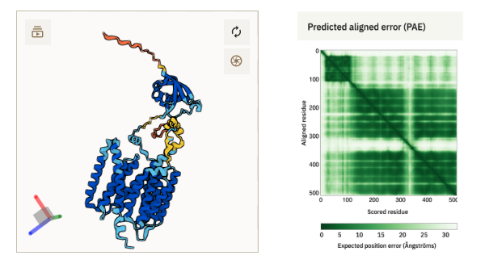
Input and Output
Input:
Amino acid sequence
Data base
Genetic Database
Structure Database
Genetic Database:
MGnify, UniProt
Uniclust30, UniRef90, BFD
Structure Database:
PDB70
Search algorithm: JackHMMER, HHBlits, HHSearch, MMseqs2
Output:
Predicted structure
Confidence level
pLDDT: local distance difference test
(per residue) accuracy
PAE: Confidence in relative position of two residues within the predicted structure

Slide 5
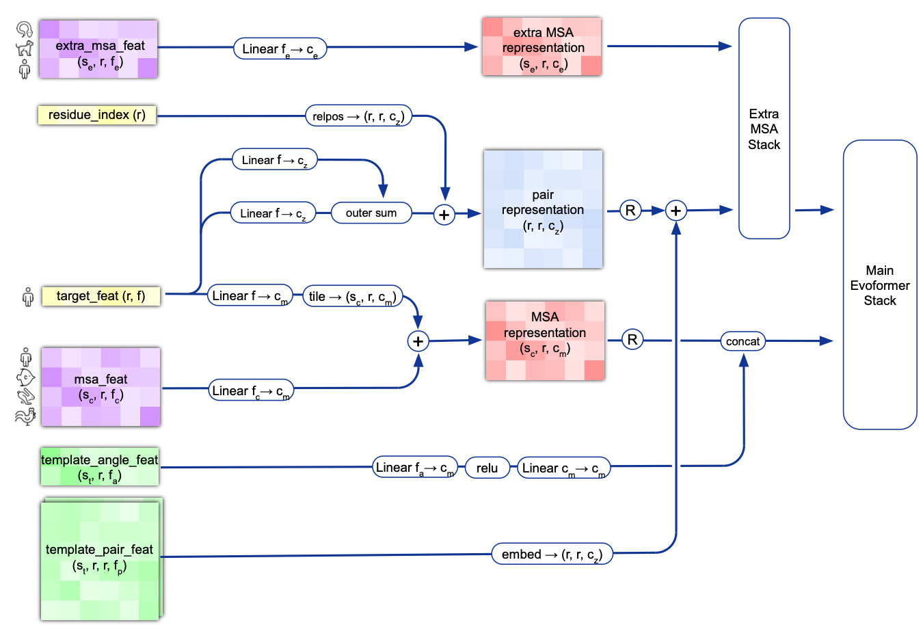
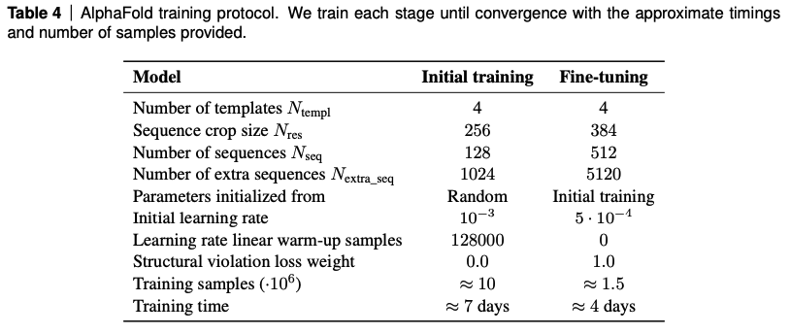
Input Embedding
features | shape | entries
target_feat | (N_{res}, 21) | aa_type (21)
residue_index | (N_{res}, )
msa_feat | (N_{clust}, N_{res}, 49) | aa_type (23), aa_distribution (23) deletion (3)
extra_msa_feat | (N_{extra}, N_{res}, 25) | aa_type (23), deletion (2)
template_pair_feat | (N_{templ}, N_{res}, N_{res}, 88) | aa_type(22) Distogram (39) unit_vector (3) mask (2)
template_angle_feat | (N_{templ}, N_{res}, 51) | aa_type (22) torsion_(alt)_angles (7+7) Mask(14)
Pair rep
(r, r, c_{z})
MSA rep
(s, r, c_{m})
s = N_{seq} = N_{clust}+ N_{templ}
How can we keep ( N_{seq} N_{res}) or (s, r) constant?
MSA clustering / resampling and ensembling
Residue cropping
Self-distillation: Training Data: 25% of PDB + 75% of self-distillation
MSA Clustering:
Residue cropping
Relative position encoding

Slide 6
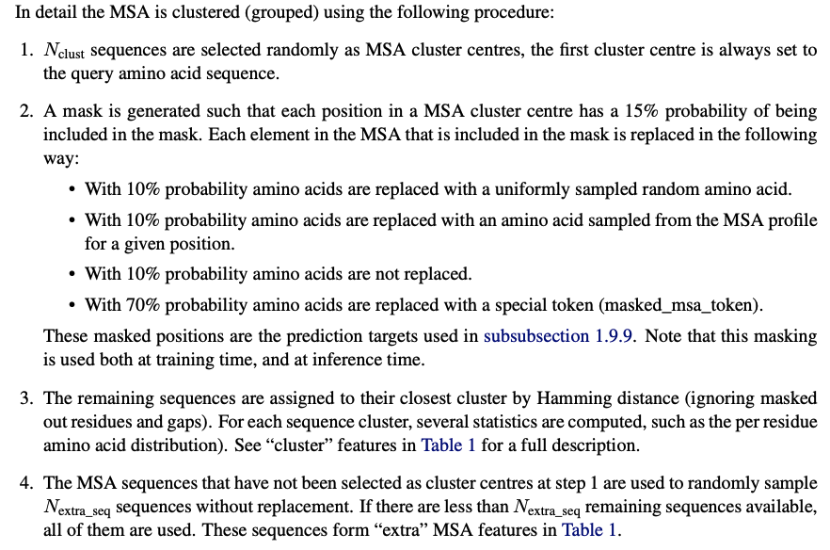
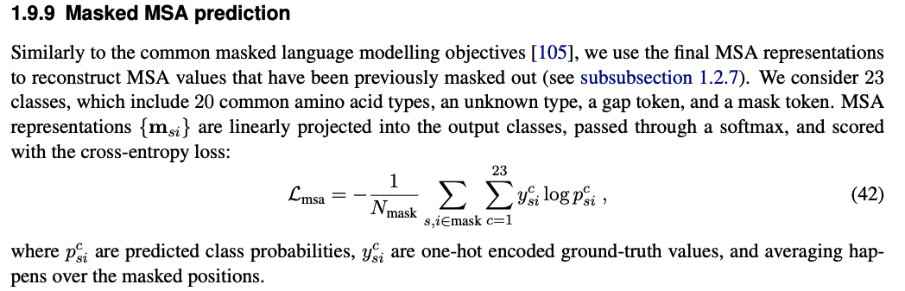
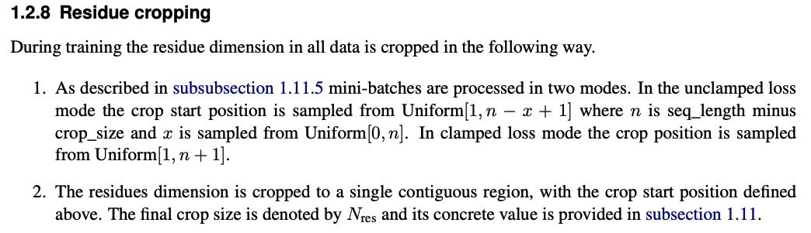
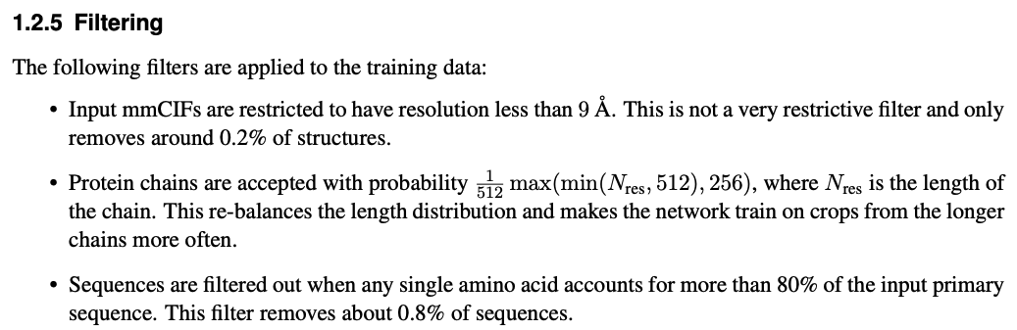
MSA Clustering: compress MSA due to memory cost by reducing redundancy
Random cluster centers
(w/ setting 1st center always the query seq)
Generate mask array (s, r)
Remaining sequences are assigned to
their closest cluster by Hamming distance
MSA resampling and ensembling to reduce stochastic effects of MSA clustering
Use different MSA samples in each iteration (N_{ensemble}=3) and recycling (N_{ensemble}=4)
N_{clust} : 124 (out of 10^{4~5} of sequences in MSA)
Residue cropping (during training)
1
y
y+N_{res}-1
L
N_{res} = 128

Slide 8
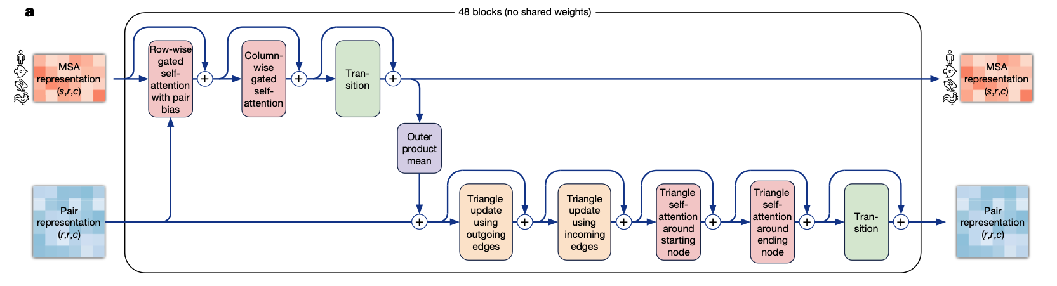
c. Evoformer
MSA rep
(s, r, c_{m})
Pair rep
(r, r, c_{z})

Slide 9
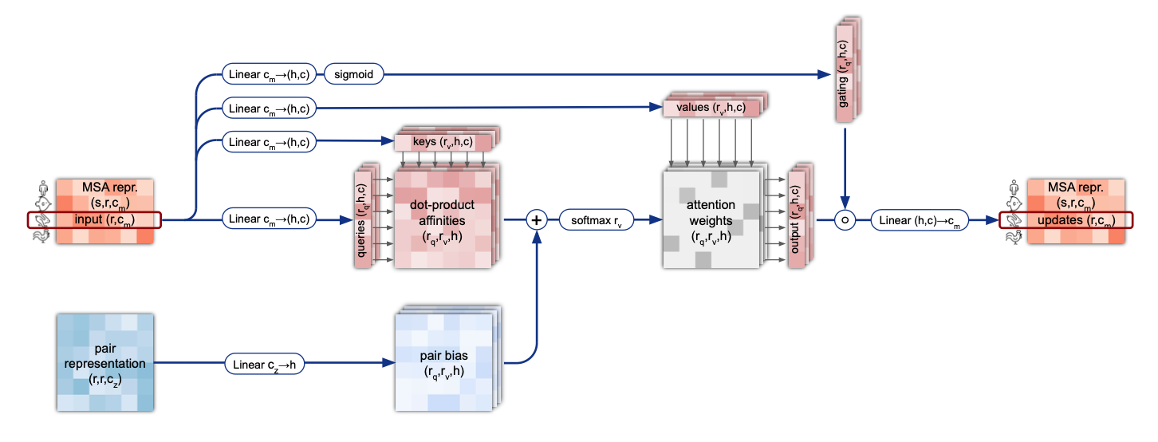
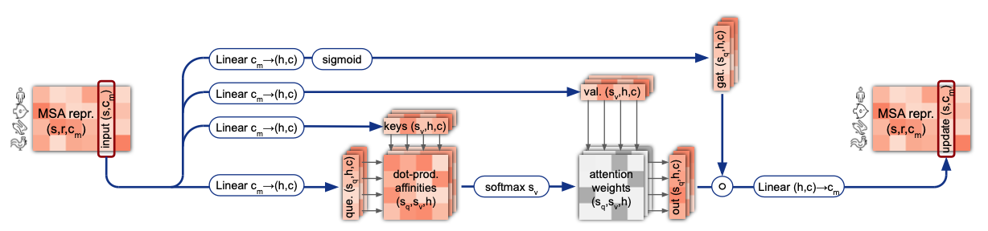
Row-wise gated
self-attention
with pair bias
Col-wise gated
self-attention

Slide 10
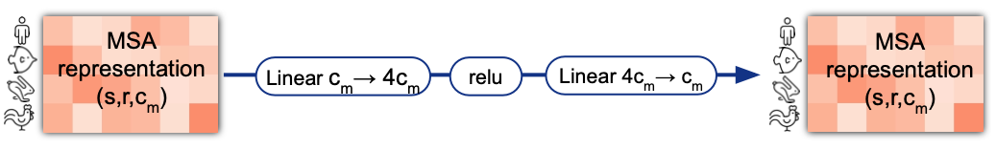
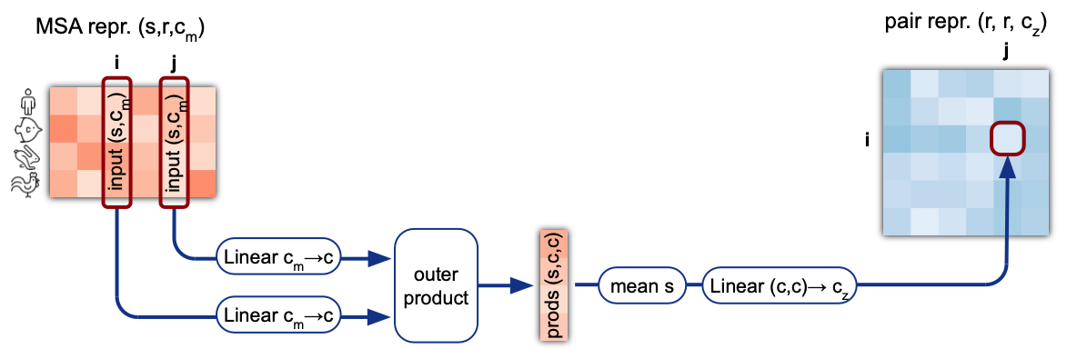
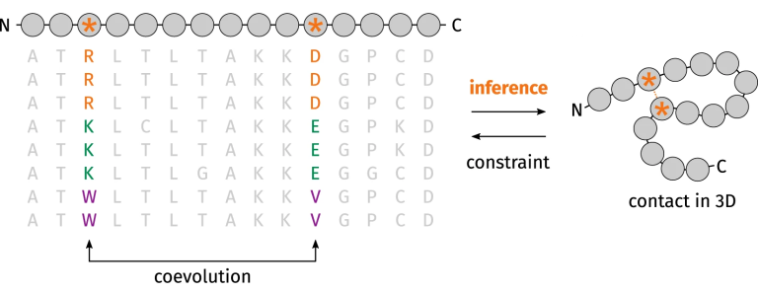

Slide 11
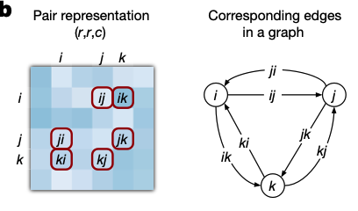
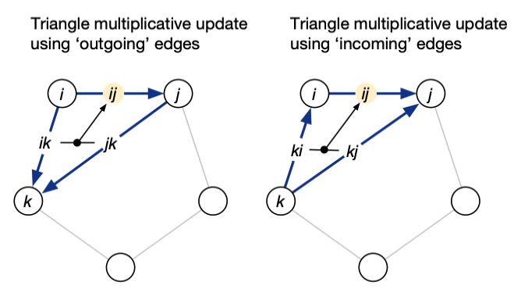
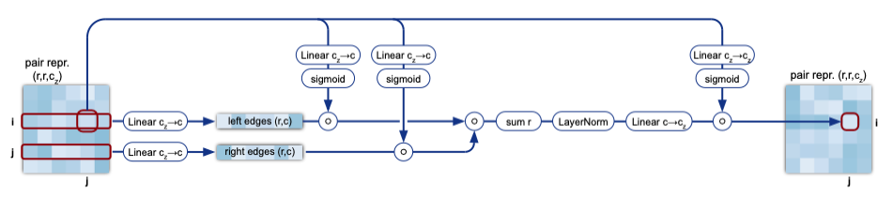
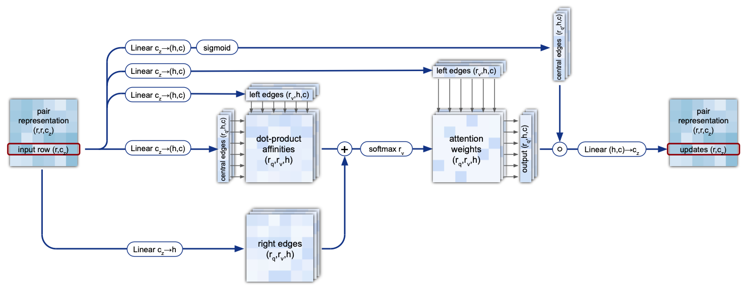
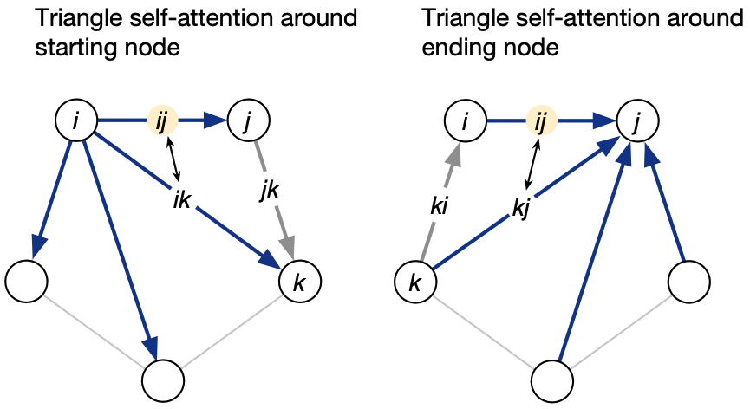
Where are all these triangles come from?
For a pairwise description of amino acids to be represent- able as a single 3D structure, many constraints must be satisfied including the triangle inequality on distances. On the basis of this intuition, we arrange the update operations on the pair representation in terms of triangles of edges involving three different nodes
Triangle update
using outgoing/incoming edges
Triangle self-attention
around starting/ending node
Notes:
The triangle multiplicative update was developed originally as a more symmetric and cheaper replacement for the attention, and networks that use only the attention or multiplicative update are both able to produce high-accuracy structures. However, the combination of the two updates is more accurate.

Slide 12
Evoformer prepares 4 types of sequence embedding to be suitable for structure prediction
row and column embedding from MSA rep, and Pair rep.
via
- Separate Multi-head Self attention layers over MSA rep and Pair rep
- Information mixing between MSA rep, and Pair rep.

Slide 13
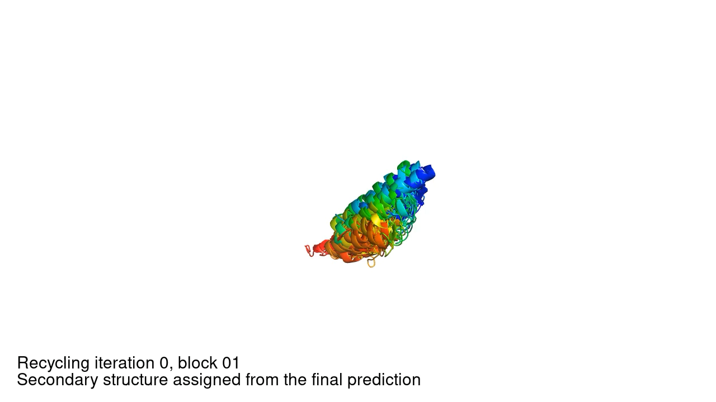
Recycling iteration step, # of Evoformers used before structure module

Slide 14
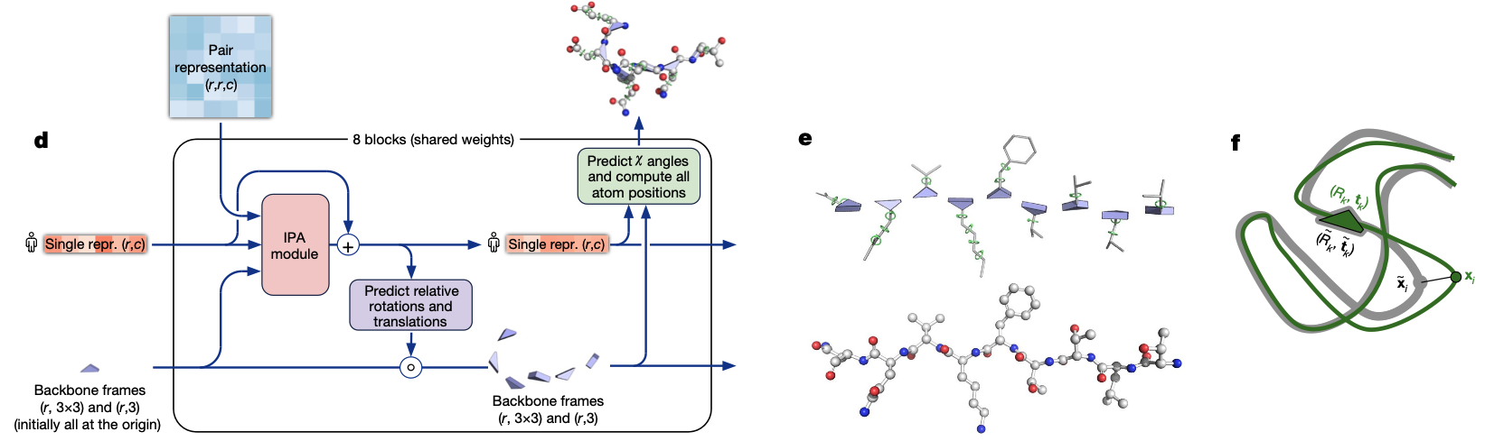
Structure module
MSA rep
(s, r, c_{m})
MSA rep
(s, r, c_{m})
Pair rep
(r, r, c_{z})
Pair rep
(r, r, c_{z})

Slide 15
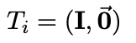
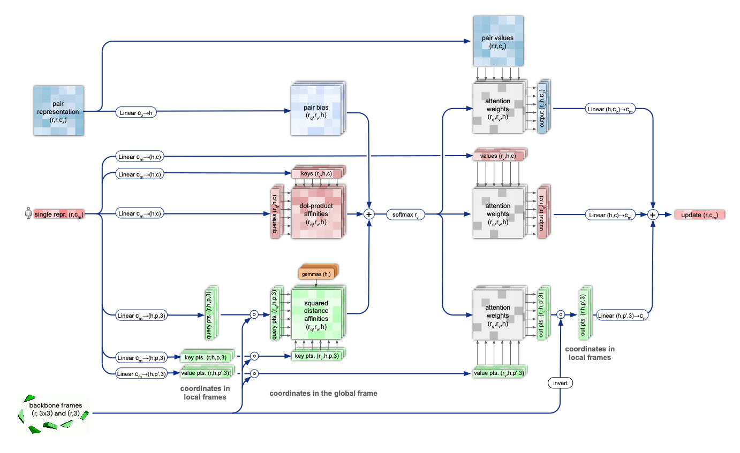
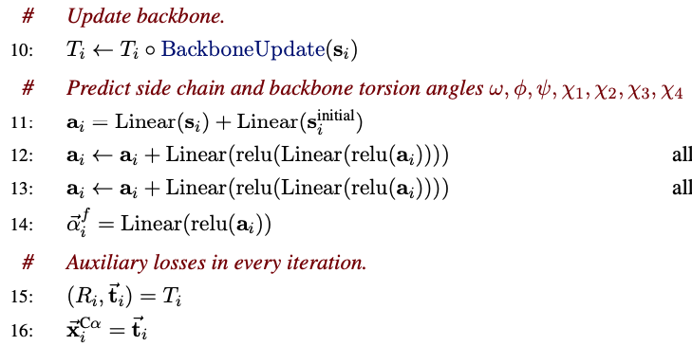
Residue Gas:
3D backbone structure is represented as N_{res} independent rotation and translation of triangle rigid body (N-C⍺-C)
Completely unconstrained peptide bond b/w neighboring residues (residue gas)
Enable the local refinement of all parts of the chain
Invariant Point Attention

Slide 16
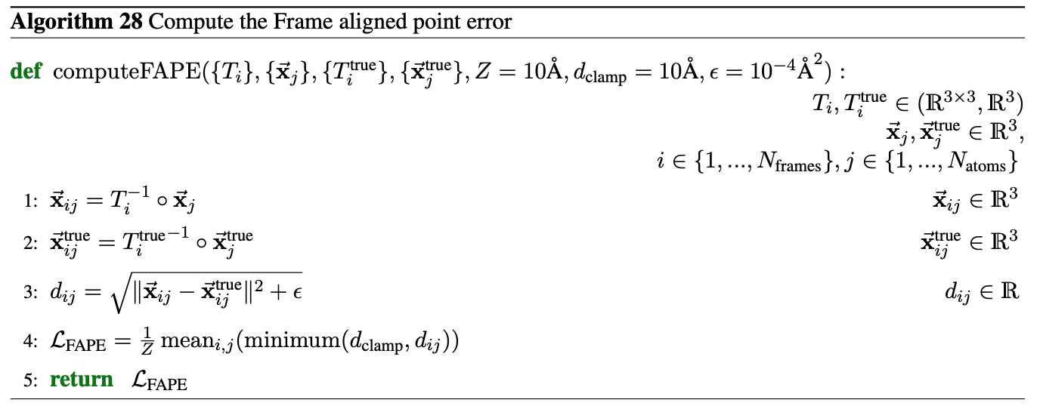
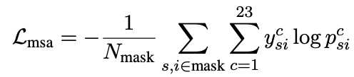
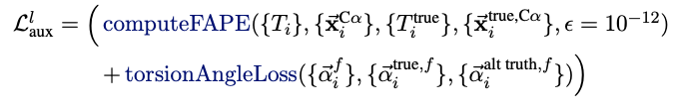
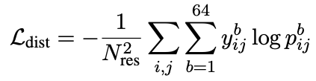
Loss
Like Masked language modelling objective
FAPE on C⍺ averaged over structure model passes (8)
Distogram on residue pairs

Slide 17
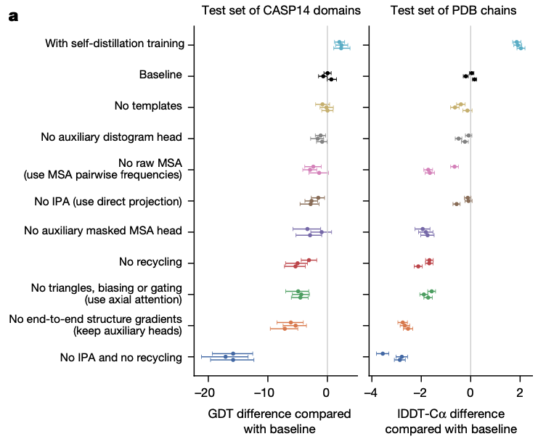
Ablation Test
Use only 1st and 2nd order frequency
Training Data comes from
self-distillation set w/ 75 %
known structure from PDB w/ 25 %

Slide 18
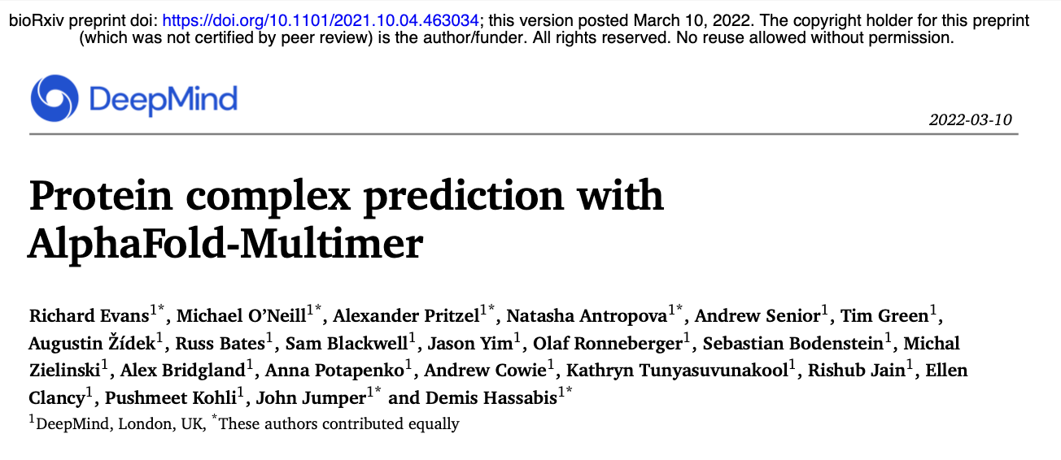
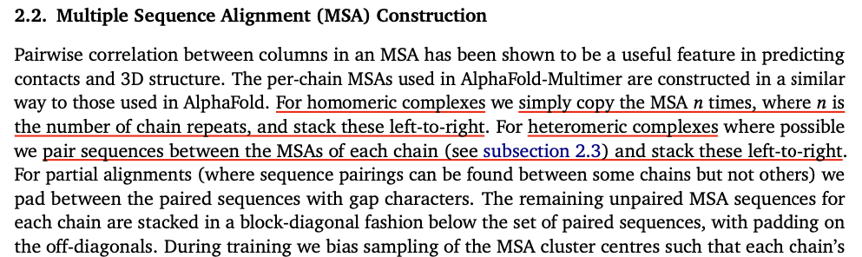
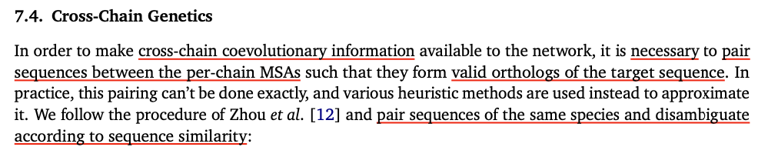
AlphaFold-Multimer
Pairing sequences b/w the per-chain MSAs based on the species labels
(derived from UniProt idmapping)
reveal cross-chain coevolutionary information

Slide 19
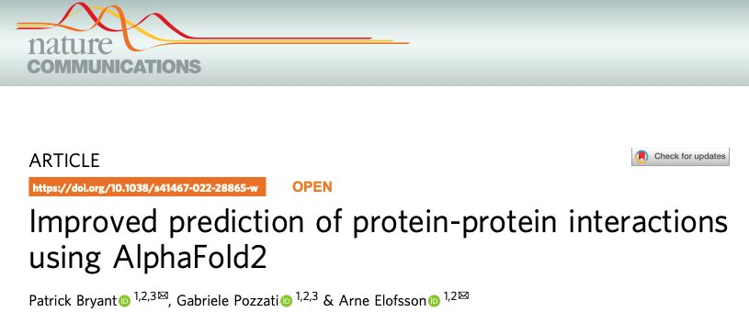

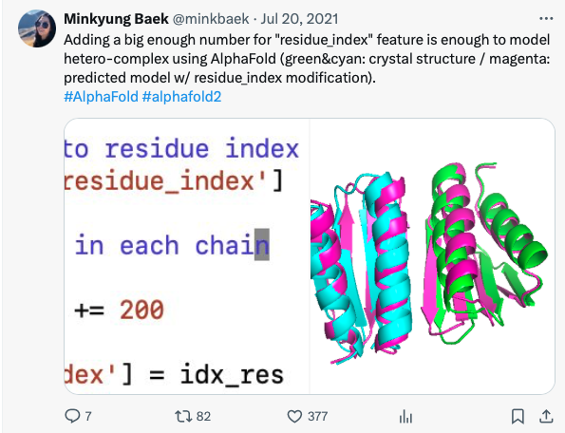
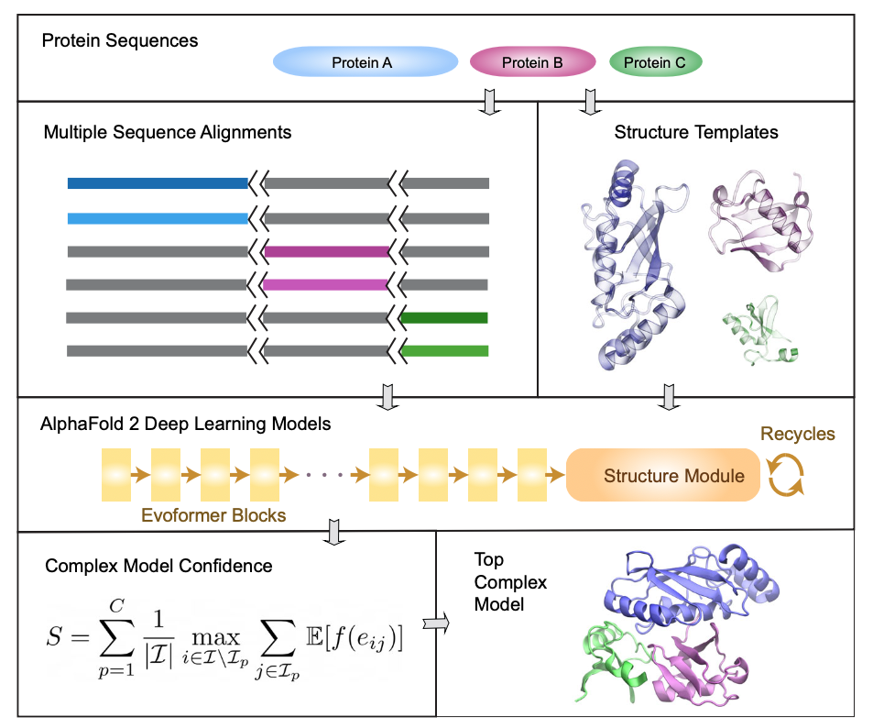
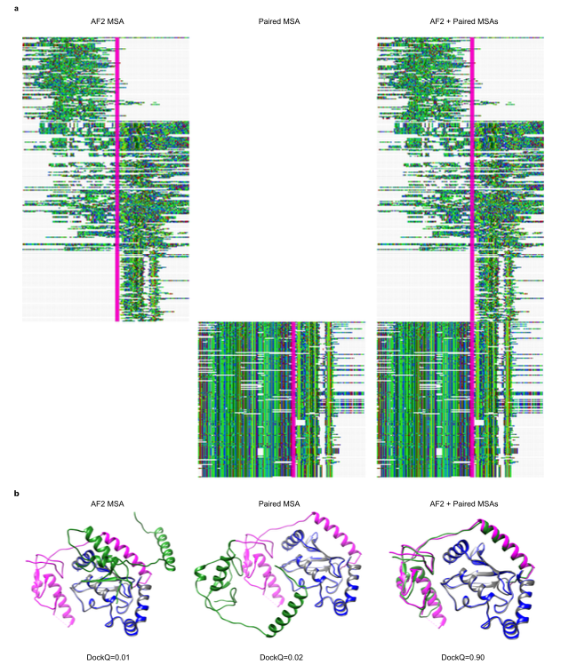
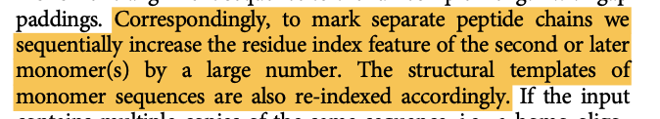
Modelling protein-protein interaction
1. MSA pairing
2. Residue re-indexing
MSA pairing is impractical:
Protein cross-talk in disease pathway
Pathogen-host interactions …
AF2 MSA
Paired MSA
AF2 MSA +
Paired MSA

Slide 20
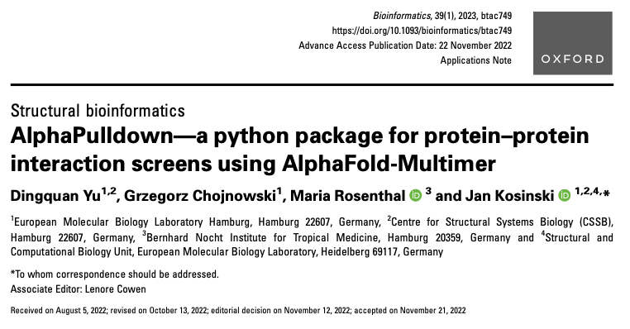
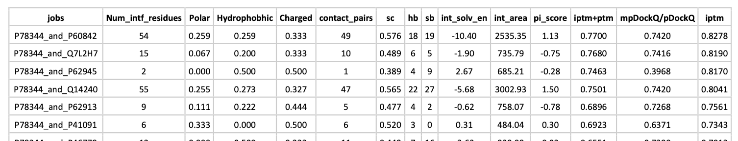
Wrapper for high-throughput experiment
Screening one protein (eIFG1) to a set of potential interacting proteins

Slide 21
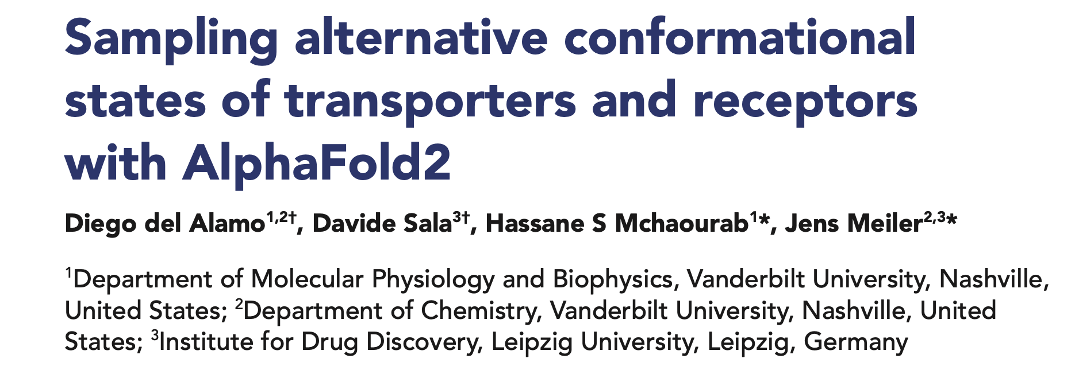
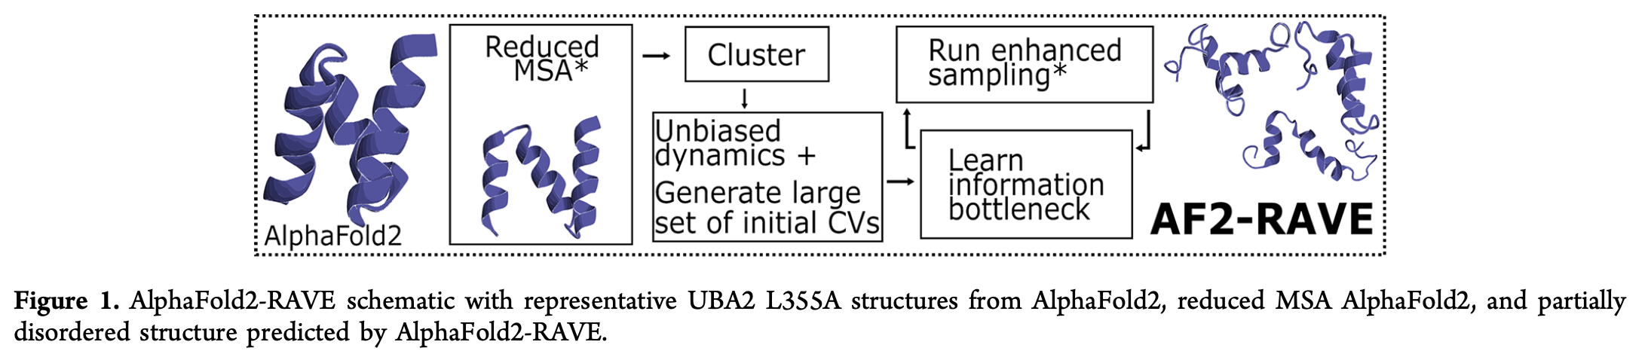
Sampling alternative states
Previous work: del Alamo eLife 2022; Vani JCTC 2023
Subsample the MSAs using built in MSA clustering (i.e. reduce max_msa_depth)

Slide 22
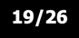
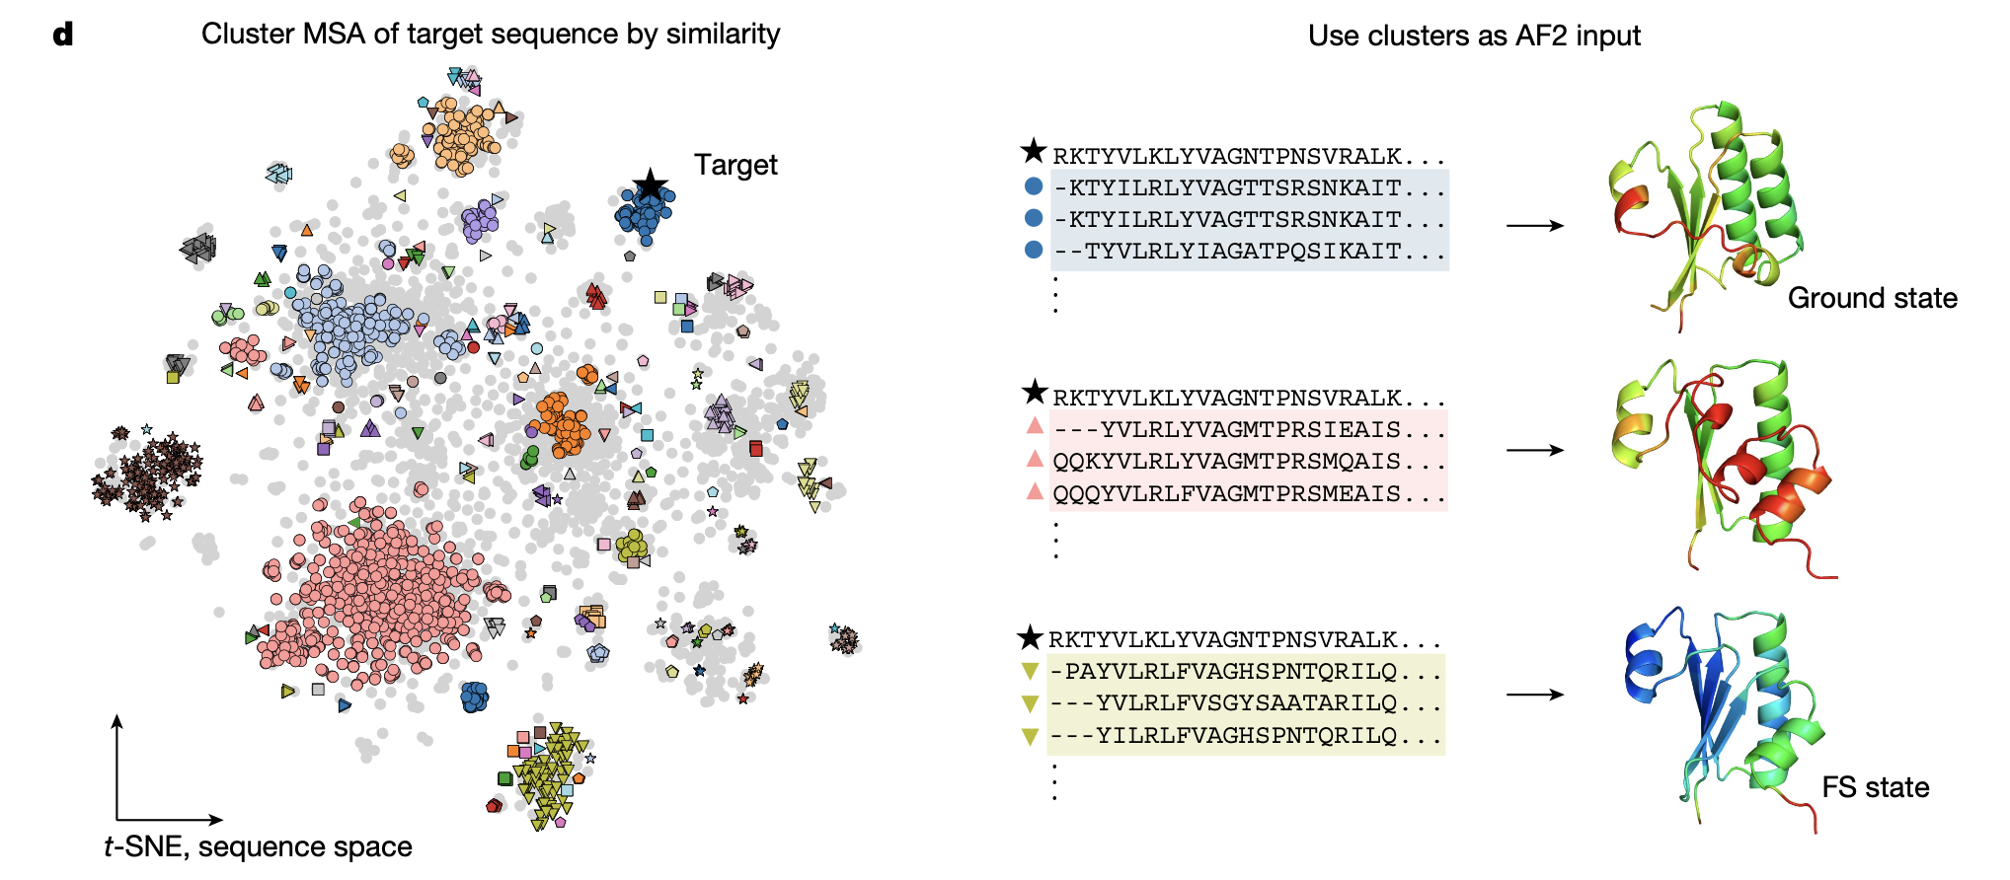
AF-Cluster (is it real?)
Chakravarty & Porter Prot. Sci. 2022 state “AlphaFold2 fails to predict protein fold switching”
Use MSA depth of 32 (following del Alamo)
AF-cluster: use coevolutionary information or just homology modeling? Porter et al. 2023 argue MSAs too shallow for coev
Notes:
edit distance with DBSCAN

